Slide 1
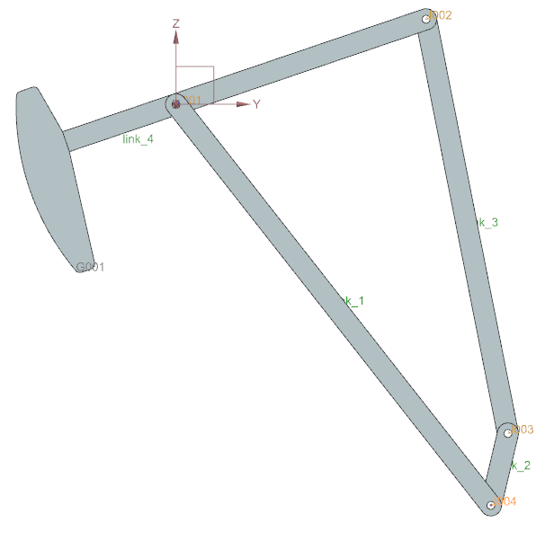
Joint 1/
Global
coordinate
Joint 2
Joint 3
Joint 4/
Power source/
actuator

Slide 2
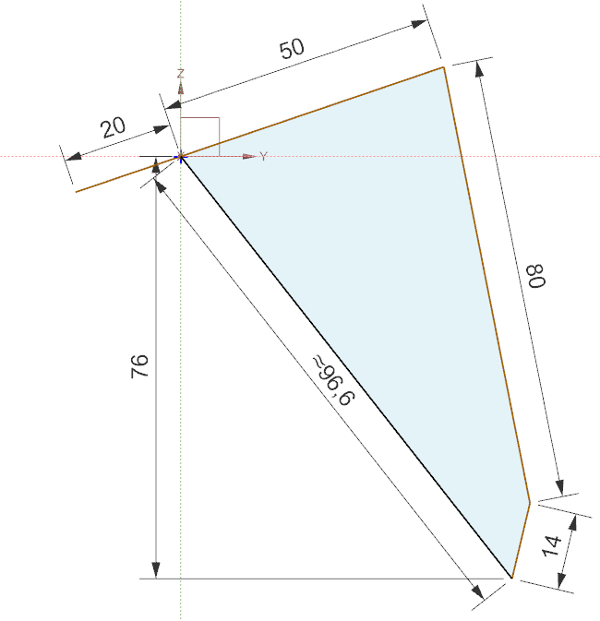
C
D
E
B
A

